Slide 1






Protein Data Bank in Europe
PDBe.org
Mihaly Varadi
ECCB 2018
Athens, 8th Sep
pdbhelp@ebi.ac.uk
proteindatabank
@PDBeurope
pdbeurope
pdbart

Slide 2
What is the PDBe?

Slide 3
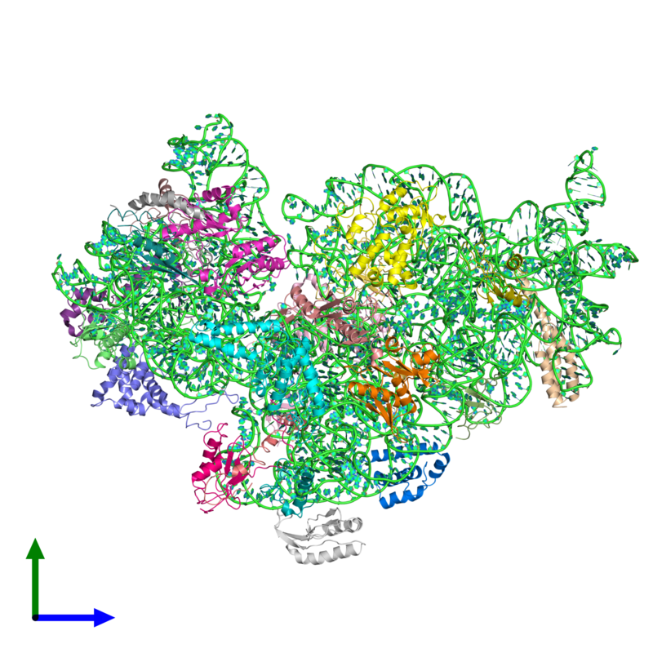
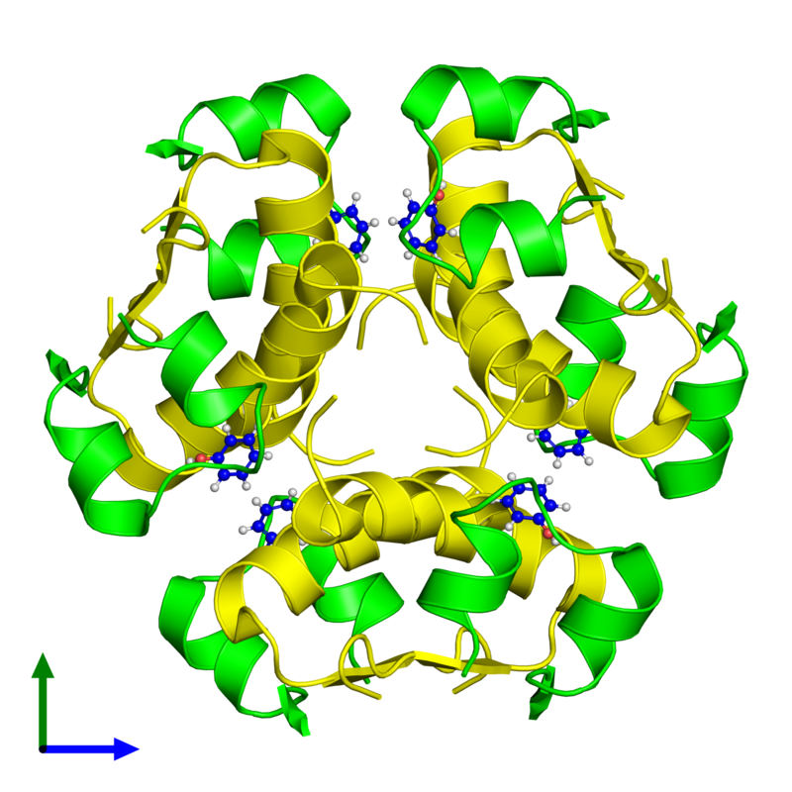
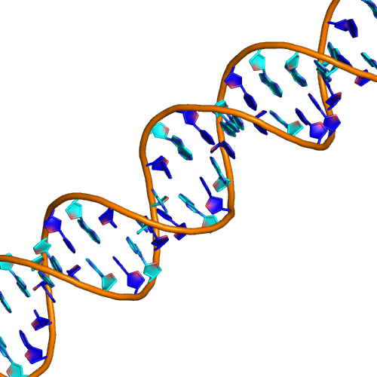
The Protein Data Bank (PDB) is an archive of experimentally determined 3-dimensional structures of biological macromolecules
Proteins DNA/RNA Complexes of Protein and NA
pdbe.org

Slide 4
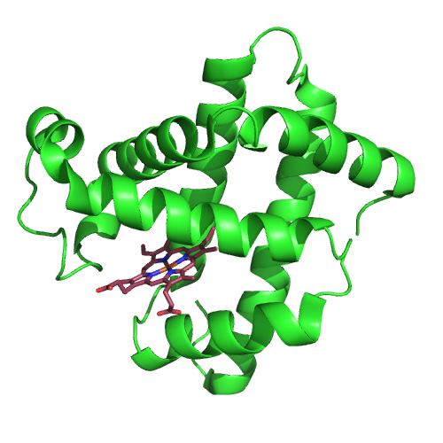

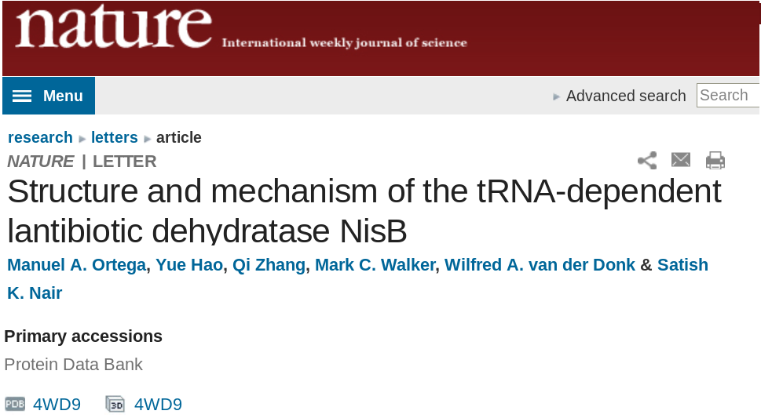
A “PDB code” refers to a structure
Described in a paper
(or maybe not published)
A unique 4 character code
Identifies the data within the PDB archive
Always starts with a number
For example: 2nuu, 4xyz, 2f48
Deposit
in the
PDB
PDB code
Referenced in a paper

Slide 5
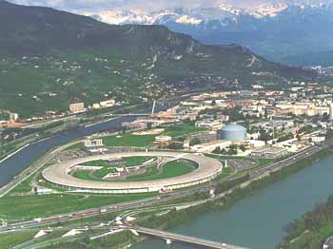
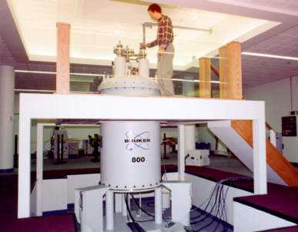
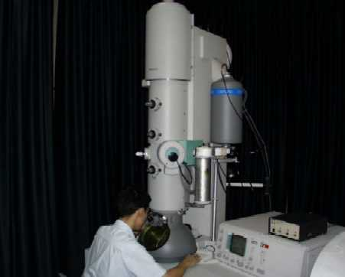
Methods for solving macromolecular structures
88% X-ray crystallography
10% NMR Spectroscopy
1% Electron microscopy

Slide 6
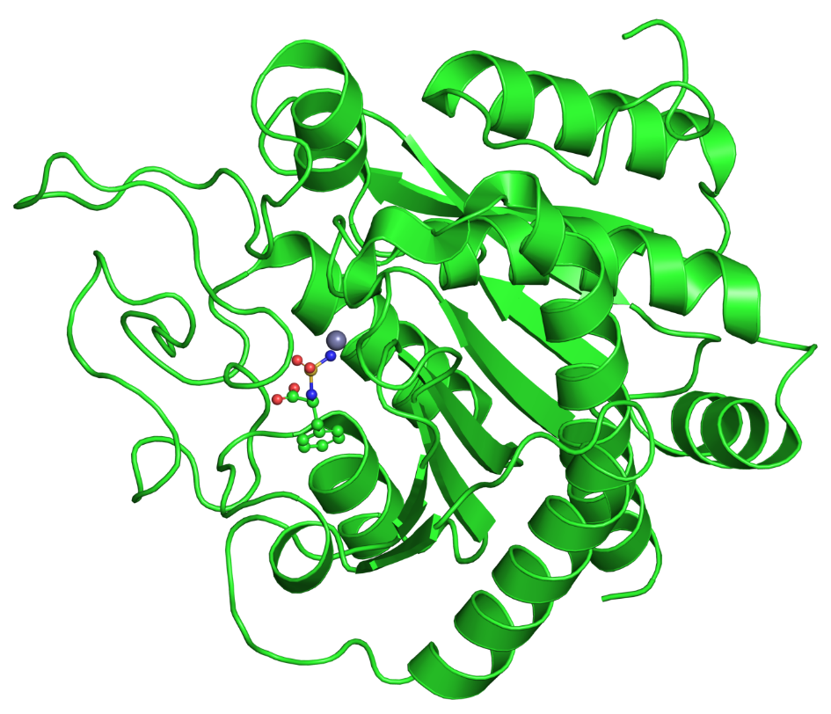
Not all 135 000 structures are unique molecules
There are 2,665 structures of bovine proteins
But only 521 different bovine proteins
Why?
Solved by different methods
With different compounds bound
By different people
Under different conditions
Carboxypeptidase A:
32 structures - 15 different small molecules

Slide 7

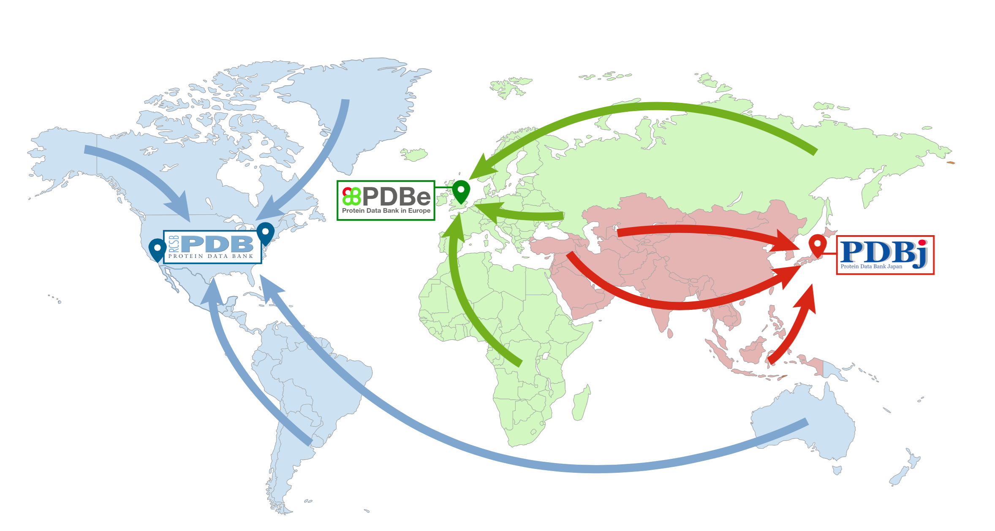


“The PDB”
FTP Archive
wwPDB.org

Slide 8




Value added data
Value added data
Value added data
Value added data
‘The PDB’
FTP Archive
wwPDB.org

Slide 9
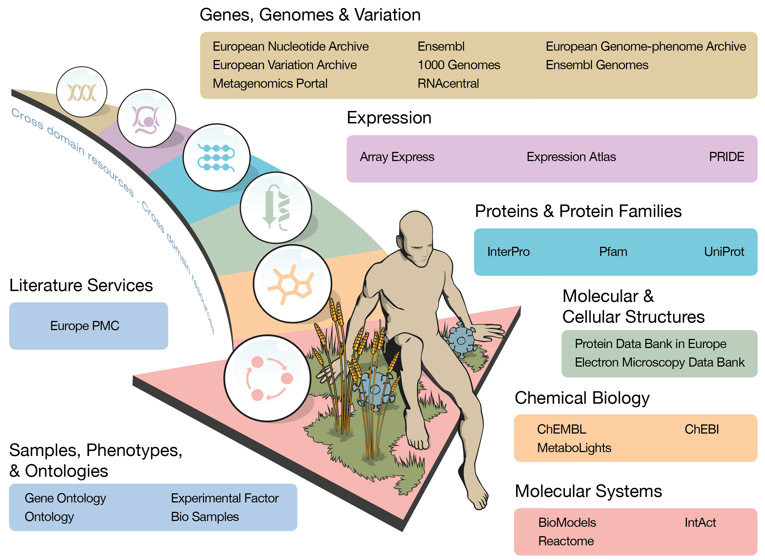
At the heart of EMBL-EBI resources

Slide 10
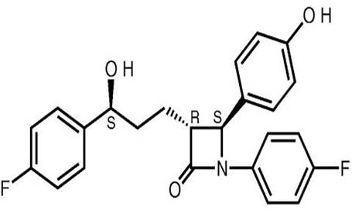
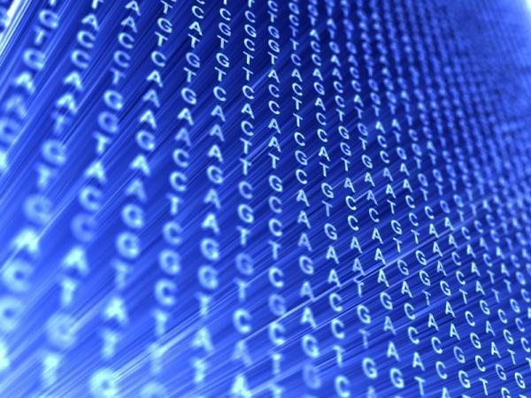
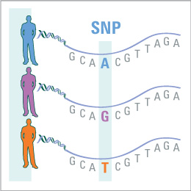

Integrating structural and other biological data
Annotating and linking structure through biological information
Chemistry
Sequences
Variation
Interactions
Pathways
Information / Resources
ChEBI
ENA/UniProt
Ensembl
ChEMBL/IntAct
Reactome

Slide 11
What is on a PDBe entry page?

Slide 12

Integrating structural and other biological data
Based on consultations with users
Data clustered in five sections
Some FAQs:
Where is the structure published?
Is it any good?
How do I find out who has cited the structure?
What is the assembly?
What sequence / structural domains are present?
Where is the ligand binding?

Slide 13
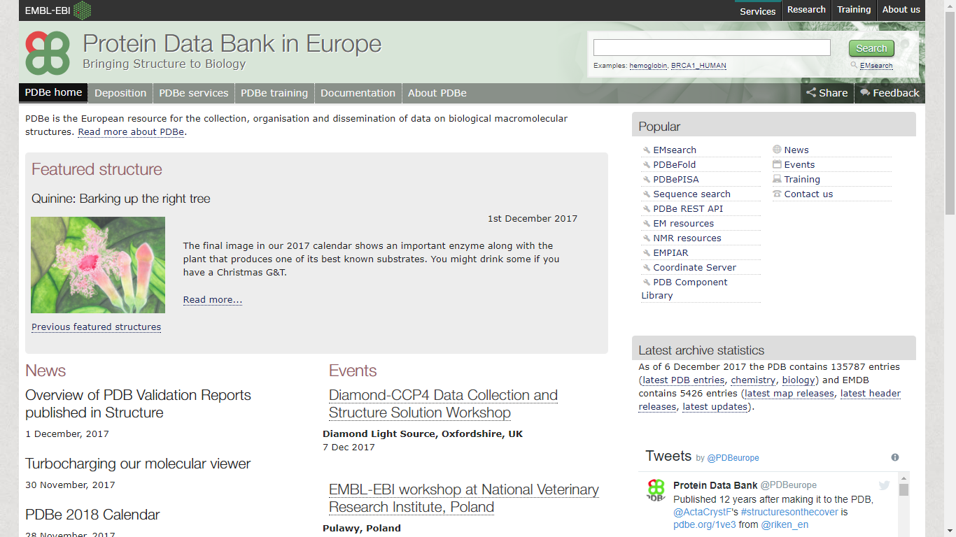
pdbe.org
Notes:
*click*
Quick links to our resources; latest entries
*click*
Easy to get to deposition
*click*
Single search box

Slide 14
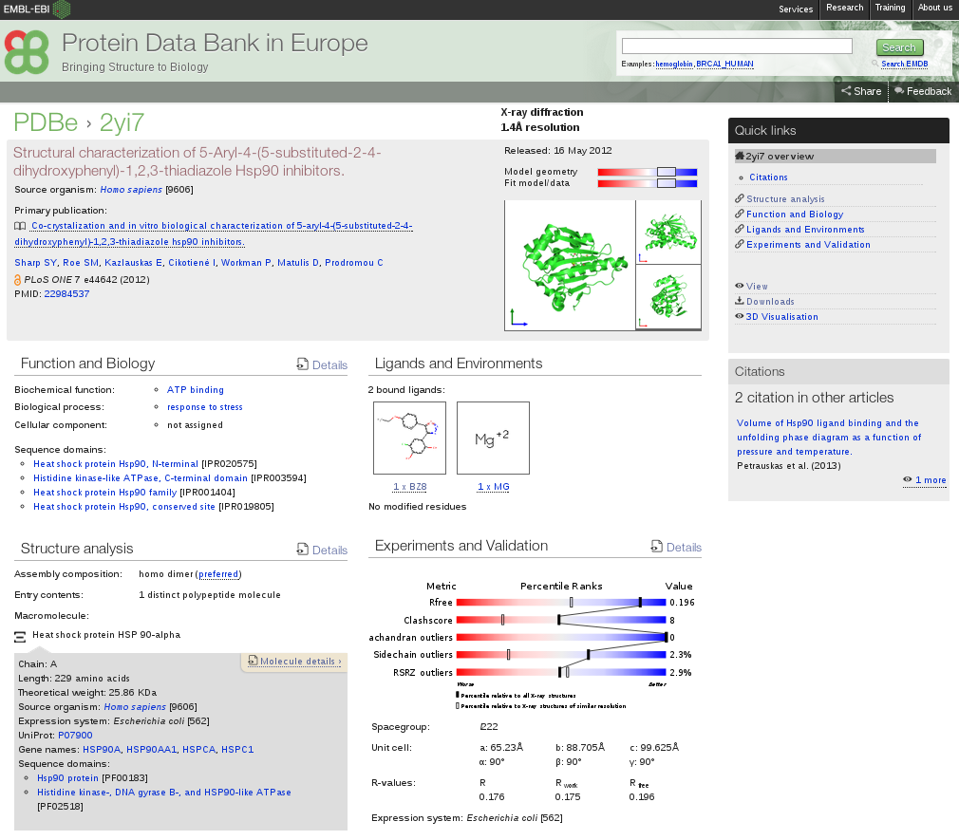
pdbe.org/2yi7

Slide 15
pdbe.org/2yi7

Slide 16
pdbe.org/2yi7

Slide 17
pdbe.org/2yi7

Slide 18
pdbe.org/2yi7

Slide 19
pdbe.org/2yi7

Slide 20
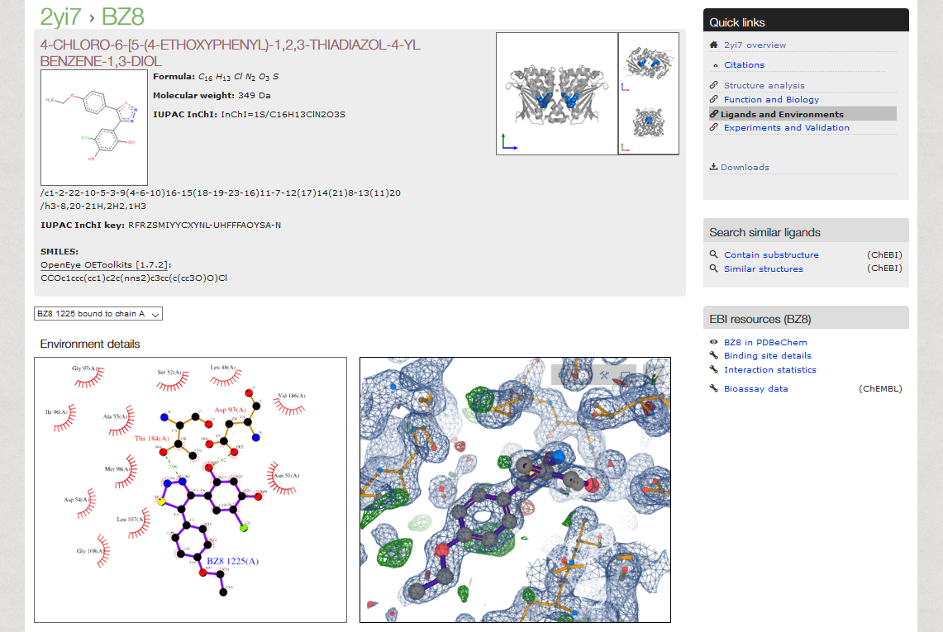

Slide 21
pdbe.org/2yi7

Slide 22
pdbe.org/2yi7

Slide 23
pdbe.org/2yi7

Slide 24
pdbe.org/2yi7

Slide 25
How good is a structure?
Resolution
Geometry
Density maps are the real data
Validation reports

Slide 26
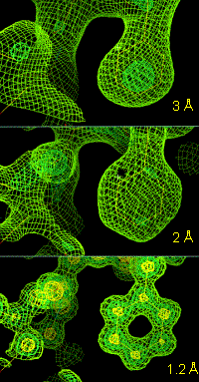
Resolution
Resolution indicates level of detail in the data
for structures determined by X-ray crystallography and electron microscopy
Higher resolution (lower number) means more detail!
Low = > 3.0 A
Medium = 1.8 - 3.0 A
High = 1.0 - 1.8 A
Atomic = < 1.0 A
But, not all parts of the structure are at the same resolution…
Notes:
More likely to put the atoms in the correct place!

Slide 27
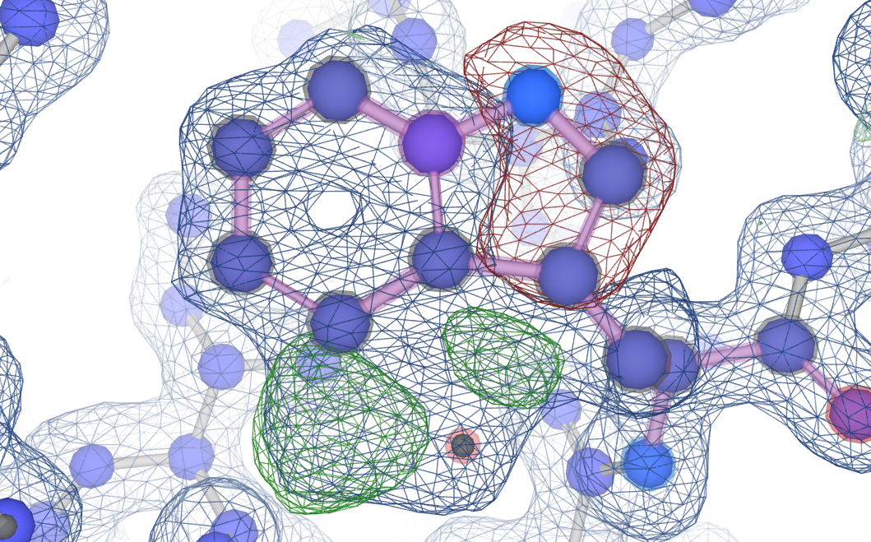
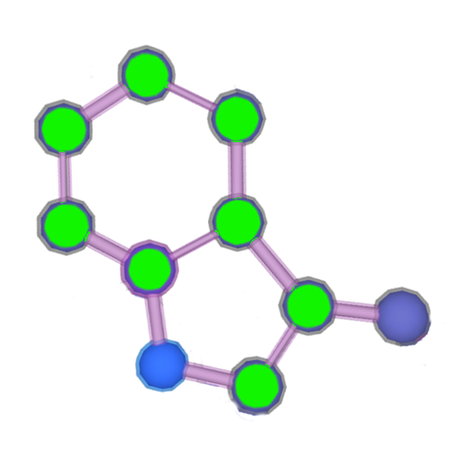
The PDB file is only an interpretation of the data
Difference density helps identify where the model does not match the data:
Areas where the model has too many atoms for the data
Data suggest too many atoms here
Areas where the model has too few atoms for the data
Data suggest too
few atoms here

Slide 28
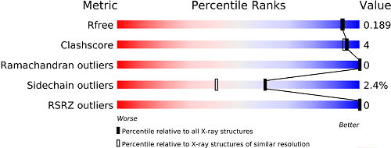
Not all structures are of equal quality
How well does the model back-predict the data?
Atoms bumping into each other
Surprising bond angles
Atoms not in electron density

Slide 29
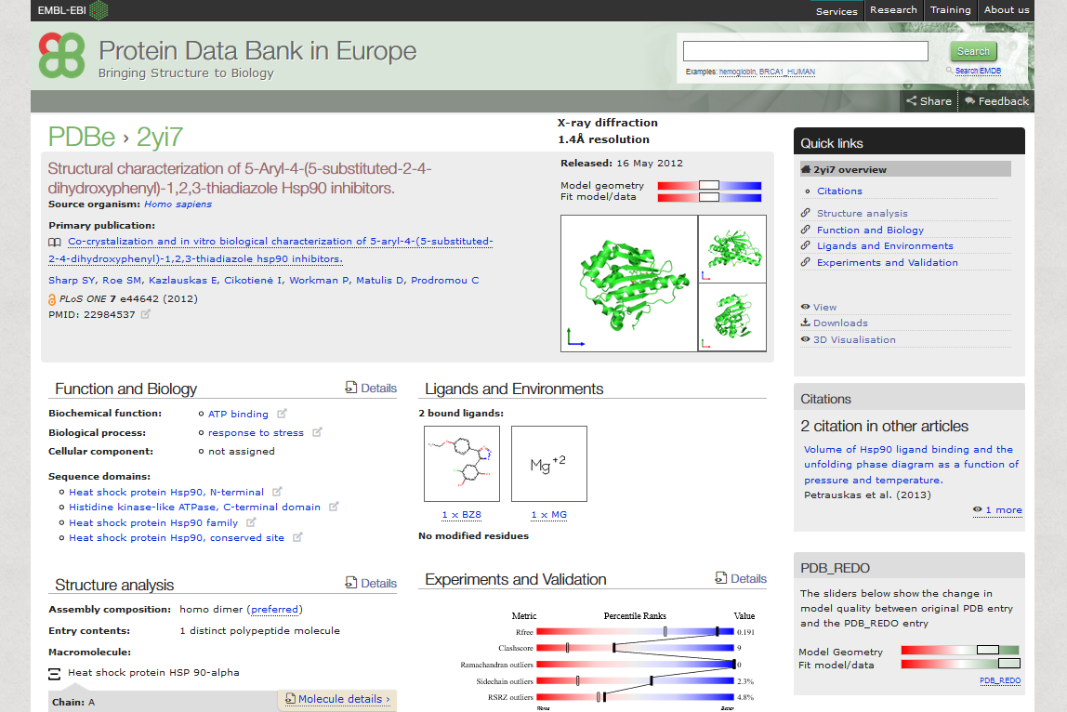
Notes:
*click*
Ligands summary

Slide 30
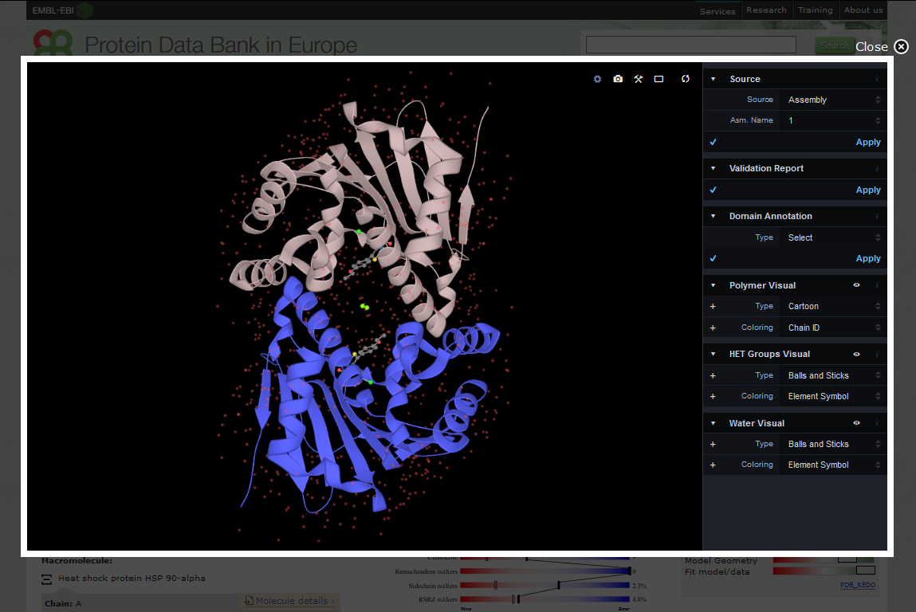

Slide 31
Hands-on part!
https://github.com/uniprot-pdbe/eccb2018/

